Slide 1
Travelling to your Secondary School

Slide 2
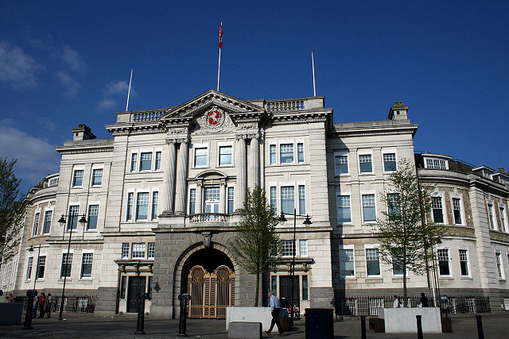
Kent Youth County Council
We are elected.
We are young people.
We represent you.
We campaign for you.

Slide 3
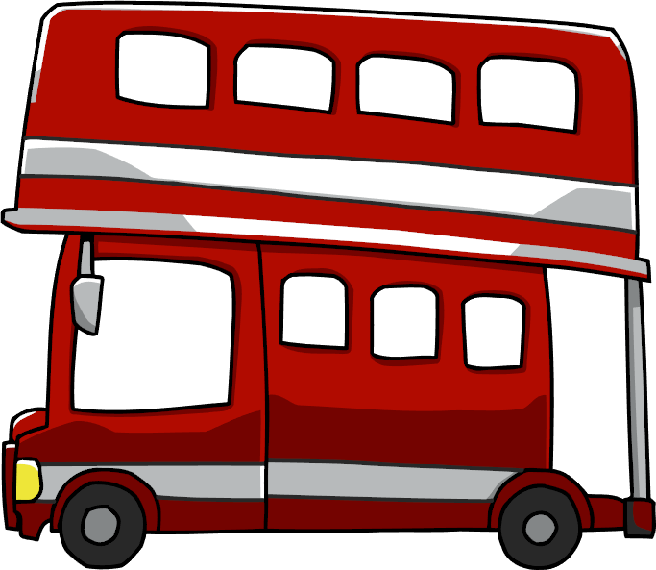
Using Public Transport

Slide 4
Part One: Using Buses

Slide 5
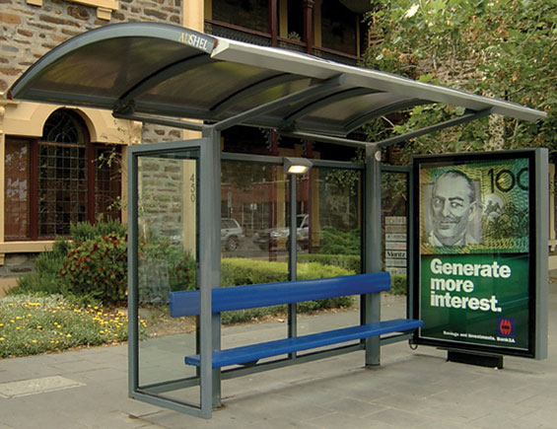
At the bus stop...
Stand on the pavement
Have a seat
Talk with friends
Be aware of
vehicles & others

Slide 6
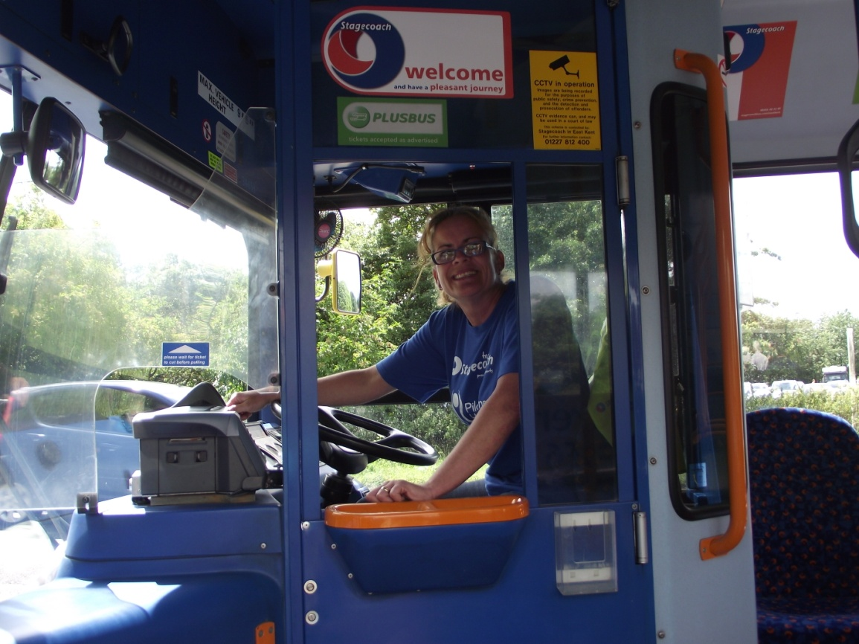
Getting on the bus...
Be polite
Let others
off first
Say ‘hello’!

Slide 7
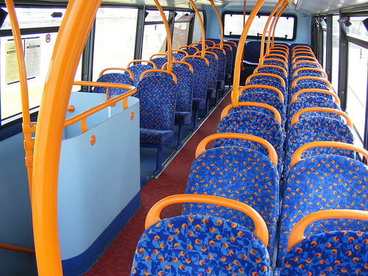
When you’re onboard...
Take your rubbish off the bus – put it in a bin!
Don’t eat messy or smelly food
Don’t be too loud
Be polite to others

Slide 8
Getting off the bus...
Be careful – watch your step!

Slide 9
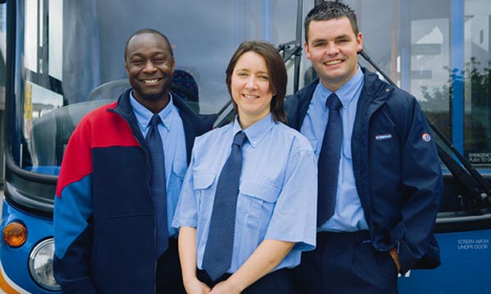
What if something happens?
You can tell...

Slide 10
Part Two: Using the Trains

Slide 11
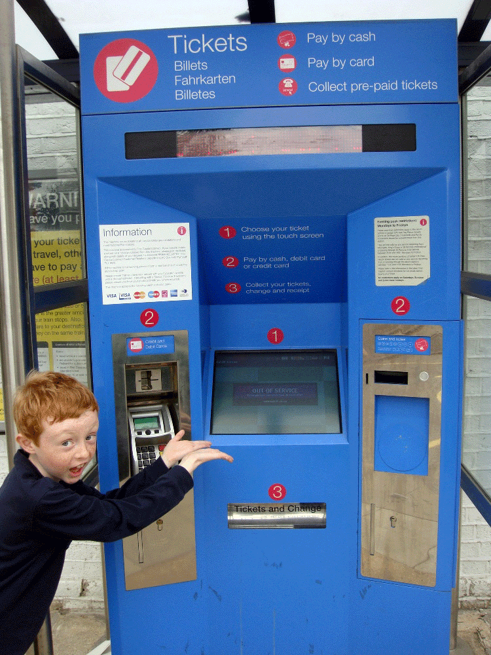
At the station...
Remember to get a ticket!
OR

Slide 12
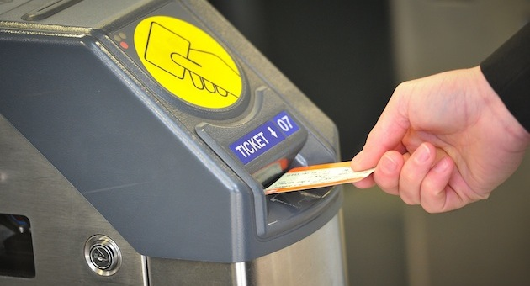
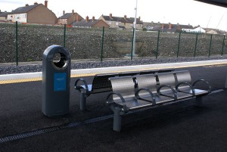
On the platform...
You might have to go through a ticket gate like this...

Slide 13
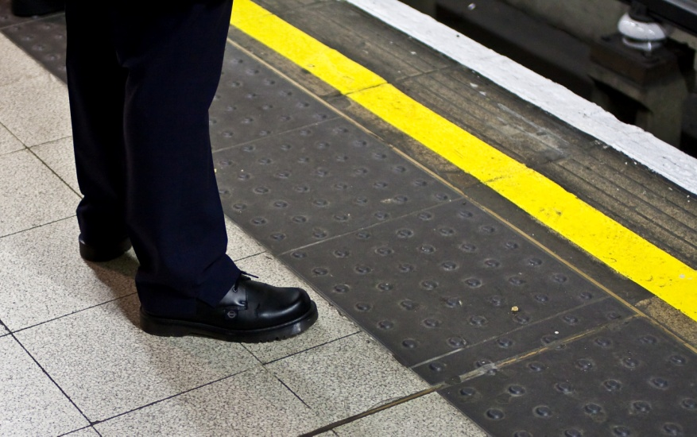
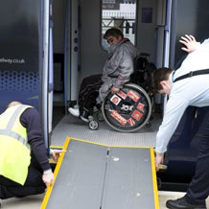
When your train arrives...
Always stand behind the yellow line until your train has stopped!
Remember some passengers need to get on and off the train first!

Slide 14
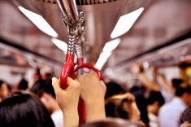
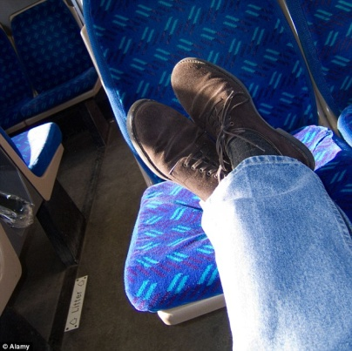
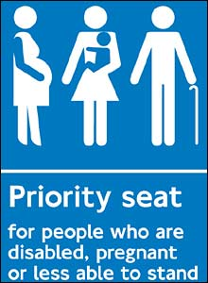
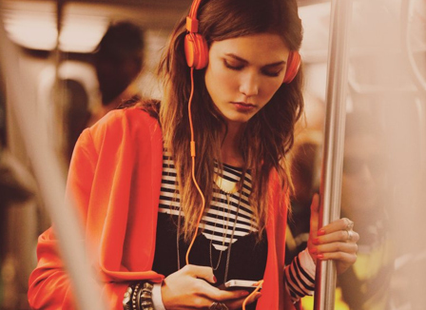
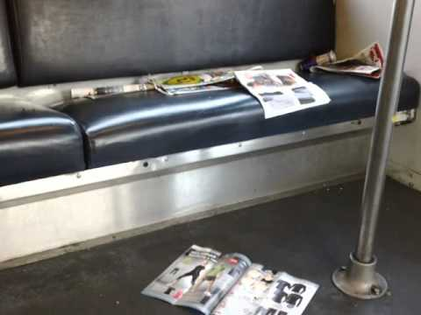
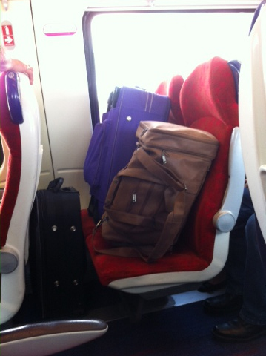
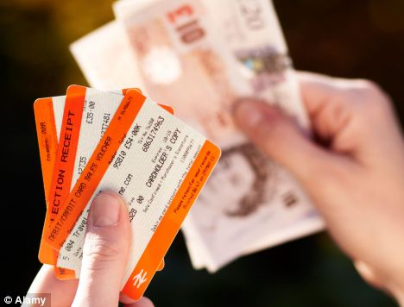
On the train...

Slide 15
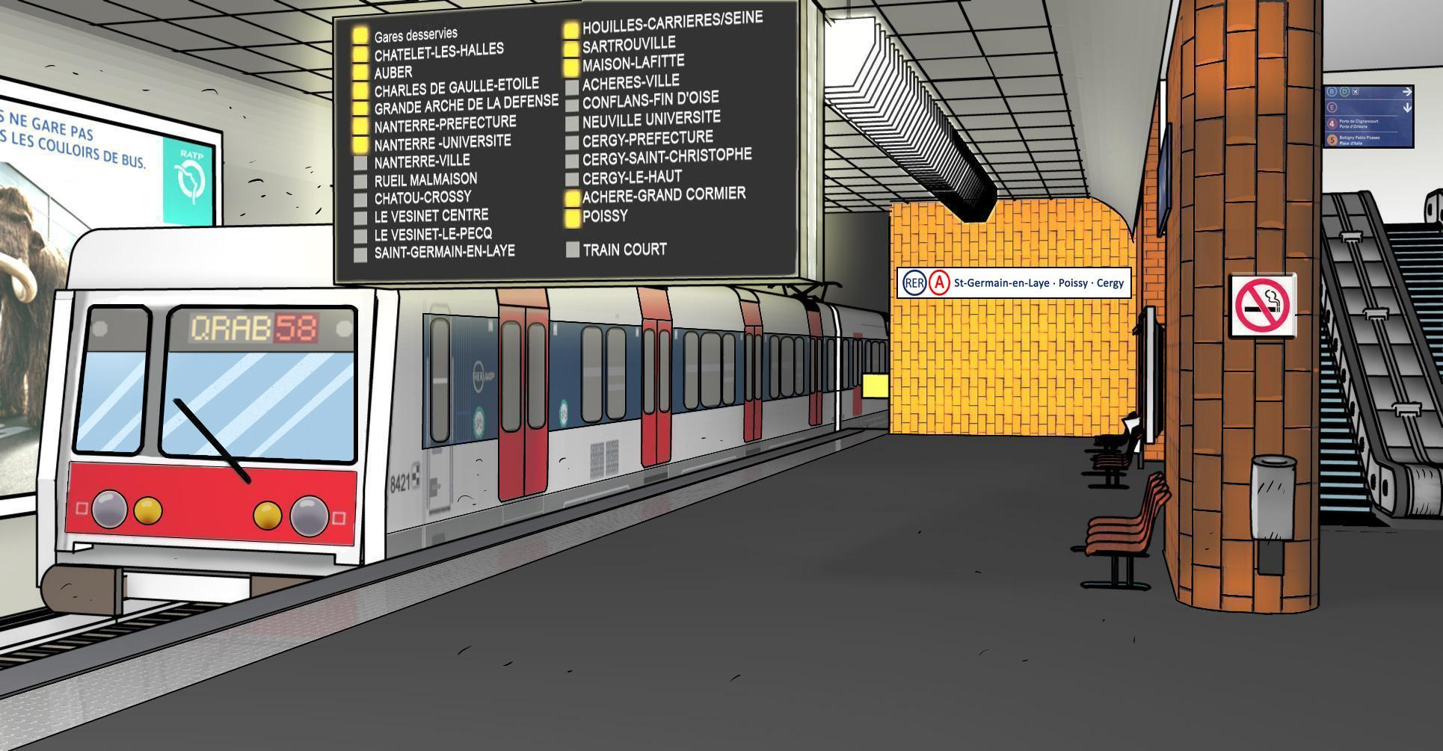
At each stop...
Stay in your seat and stay away from the doors if you are not getting off the train!

Slide 16
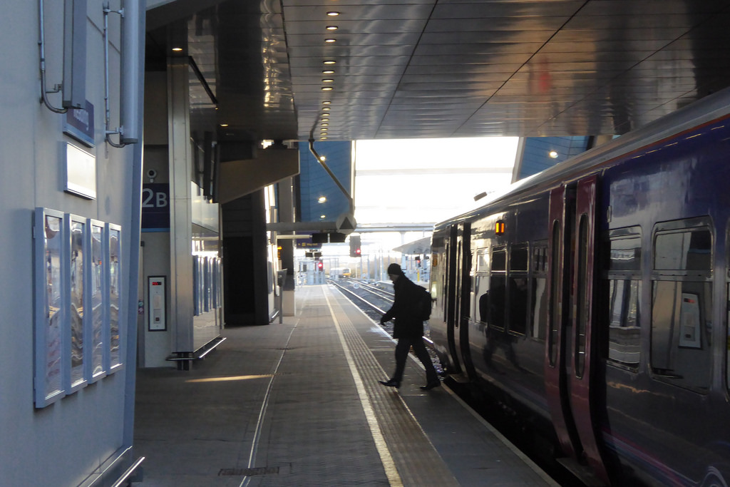
At your stop...
Take everything with you and be careful getting off the train!

Slide 17
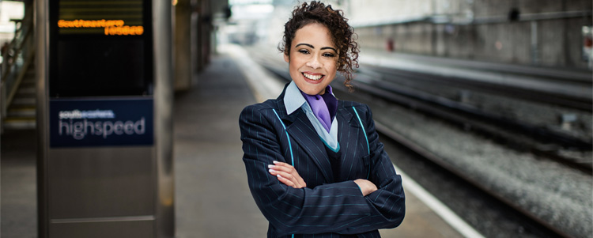
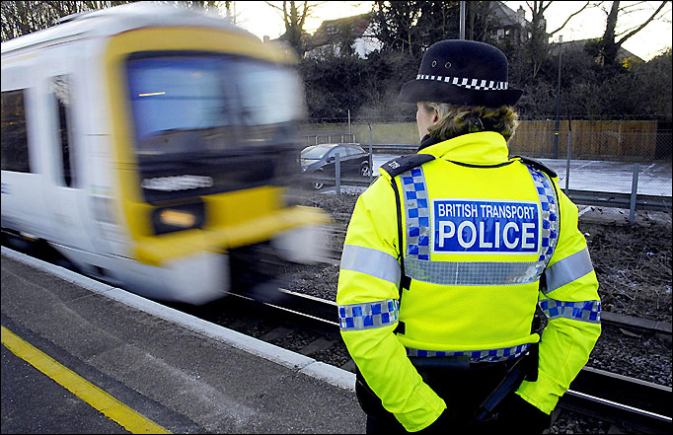
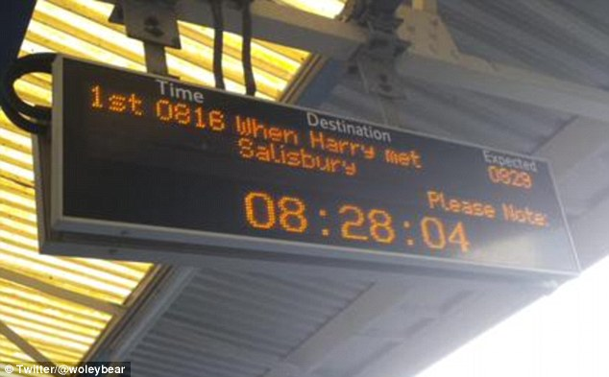
Extra information...

Slide 18
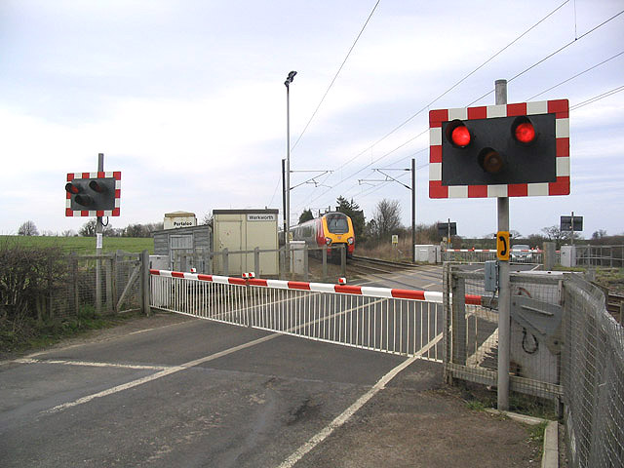
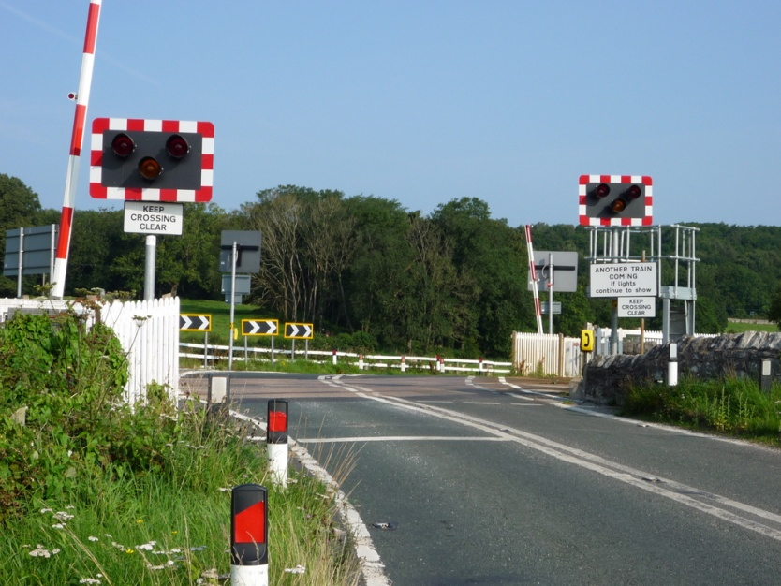
Crossing a Railway...
DO NOT CROSS!
SAFE TO CROSS!

Slide 19
Quiz
What should you do at a
Bus stop?
Click ONE option above...
Always stand up
Always stay away from the road
Climb up the bus stop and jump off

Slide 20
Quiz
What should you do at a
Bus stop?
Well Done!
Always stand up
Always stay away from the road
Climb up the bus stop and jump off

Slide 21
Quiz
What shouldn’t you do on a train?
Click ONE option above...
Sit down or hold on to the overhead rails
Be polite
Be loud and annoying

Slide 22
Quiz
What shouldn’t you do on a train?
Well Done!
Sit down or hold on to the overhead rails
Be polite
Be loud and annoying

Slide 23
Quiz
What’s the most important thing to do at a train station?
Click ONE option above...
Grab a chocolate bar
Stay behind the yellow line at all times
Have a sit down

Slide 24
Quiz
What’s the most important thing to do at a train station?
Well Done!
Grab a chocolate bar
Stay behind the yellow line at all times
Have a sit down

Slide 25
Quiz
You see someone drop a bit of litter. What do you do?
Click ONE option above...
Pick it up and put it in a bin – off the bus
Ignore it – someone else will deal with it
Leave your litter as well

Slide 26
Quiz
You see someone drop a bit of litter. What do you do?
Well Done!
Pick it up and put it in a bin – off the bus
Ignore it – someone else will deal with it
Leave your litter as well

Slide 27
Quiz
Will you be polite, safe and sensible on public transport?
Click ONE option above...
Yes
Yes
Yes

Slide 28
Quiz
Will you be polite, safe and sensible on public transport?
Well Done!
Yes
Yes
Yes

Slide 29
Thank you for
listening!

