Slide 1

Mental Health
Everyone Has It!

Slide 2



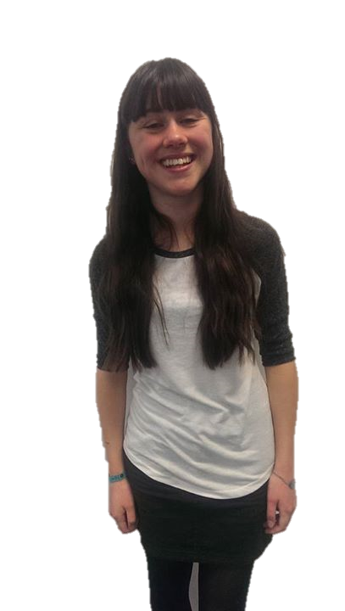

Who Has a Mental Illness?
Here are 5 young people.
Can you tell who is suffering from a mental illness?
No, you can’t! Mental Illnesses are usually invisible, but have huge effects on people’s lives.
Notes:
Images – Young People – KYCC – Owned by KYCC

Slide 3
What is Mental Health?
A person’s condition with regard to their psychological and emotional well being.
¼ of the population experience some kind of mental health problem.
Anxiety and depression are the most common problems with around 1 in 10 people affected at any one time.
Mental health issues can be severe and long-lasting and have a big impact on people’s ability to get on with life.
Notes:
Explain Mental Health and terminology used.

Slide 4
Society’s View of Mental Health
There is a stigma attached to mental health problems.
People feel uncomfortable about these issues and don’t want to talk about them much.
Many people don’t even feel comfortable talking about their own feelings.
It’s healthy to know and say how you’re feeling.
Notes:
Explain Mental Health and terminology used.

Slide 5
Examples of Mental Health Issues
Anxiety and Panic Attacks
  Creates unease, worry and fear
  Sitting an exam, getting stressed or moving can create anxiety
  Princess Diana and Johnny Depp suffered from panic attacks
Eating Disorders
  1.6 million people in the UK are affected by an eating disorder
  Includes anorexia, nervosa and bulimia
  Eating disorders are 7 to 10 times more common in women than men
  Lindsay Lohan and Lady Gaga suffered from eating issues
Notes:
Go through and explain the 5 examples (and celebrities):
Anxiety / panic attacks
Eating disorders
Body Dysmorphic Disorder
Depression
OCD

Slide 6
Examples of Mental Health Issues
Body Dysmorphic Disorder
  Feeling of shame, guilt and laziness or self harm
  Where a person becomes obsessed with imaginary ‘defects’ in their appearance
  Lily Allen suffered from Body Dysmorphic Disorder
Depression
  Making everything in life harder than it needs to be making you feel emotionally and physically drained and at it’s most severe times, it can make you feel suicidal
  Clinical depression is more than simply feeling unhappy or fed up for a few days and lasts much longer
  Winston Churchill suffered from Depression
Notes:
Go through and explain the 5 examples (and celebrities):
Anxiety / panic attacks
Eating disorders
Body Dysmorphic Disorder
Depression
OCD

Slide 7
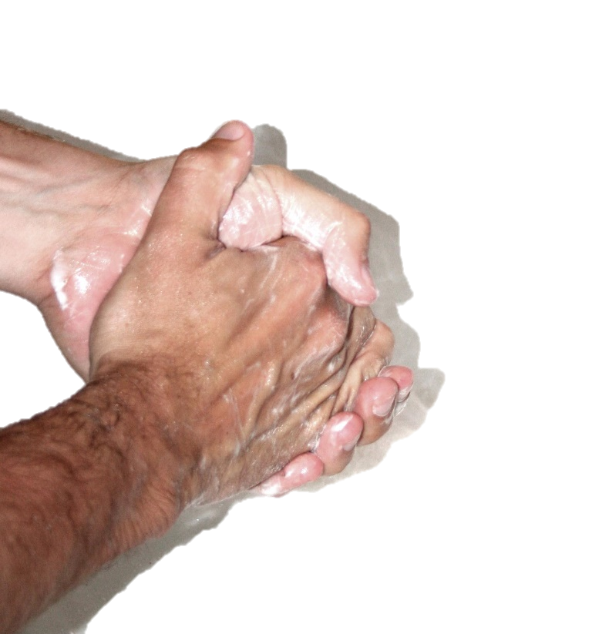
Examples of Mental Health Issues
Obsessive Compulsive Disorder (OCD)
  Creates compulsions or repetitive activities that mentally you feel you have to do
  Creates obsessions and unwelcomed thoughts, images, urges or doubts that repeatedly appear in your mind
  Charles Darwin and David Beckham suffered from OCD
Notes:
Go through and explain the 5 examples (and celebrities):
Anxiety / panic attacks
Eating disorders
Body Dysmorphic Disorder
Depression
OCD
Image – Hand Wash - https://upload.wikimedia.org/wikipedia/commons/1/1b/OCD_handwash.jpg - Labelled for Reuse with Modification

Slide 8

Causes of mental health
Physical (Biological)
Social and Environmental
Genetic make-up can contribute to the risk of developing a mental illness
Traumas to brain can sometimes lead to personality changes & can trigger symptoms
Deficiencies of certain vitamins and minerals and diets can play a role.
Factors around us
Where we live
Living conditions
School & work stress
Bullying
Notes:
Discuss these topics, making sure students understand there can be a combination of factors and others.
Image – Social Media Personal - https://pixabay.com/en/social-media-personal-552411/ - Free for Commercial Use

Slide 9

Causes of mental health
Psychological
Family history
Your psychological state
Coping with past and current traumatic experiences
Abuse, death and parents
Mental & emotional state has an influence on mental health
Family background can play a role in the development of some illnesses
Family and everyday life can play a role
However other factors play a greater role
Notes:
Discuss these topics, making sure students understand there can be a combination of factors and others.
Image – Family - https://pixabay.com/en/family-people-mother-and-father-310364/ - Free for commercial use

Slide 10
Why is there a stigma?
Society in general has stereotyped views about mental illness and how it affects people.
Many people believe people with mental health issues are violent and dangerous.
Lack of understanding and misbelief add to stigma.
In fact they are more at risk of being attacked or harming themselves than harming other people.
Stigma and discrimination worsen mental health problems!
To help the most – we need to stop this in our schools.
The best way to help is to talk!
Notes:
Discuss stigma in schools and workplaces and dangers.

Slide 11
Examples of Symptoms
Depression:
Low moods
Low self esteem
Change in appetite
Low energy
Lack of Will
Excessive sleeping
Inability to concentrate
Anxiety:
Fears of panic, fear and uneasiness
Problems sleeping
Shortness of breath
Heart palpitations
Nausea
Dizziness
Just because you feel you may have these symptoms, it doesn’t necessarily mean you have a mental illness.
But it doesn’t hurt to make sure.
Notes:
Explain symptoms and discuss that you may or may not have a mental illness if you have them.

Slide 12
Examples of Symptoms
Schizophrenia
  Hallucinations
  Delusions
  Confused thoughts
  Losing interest and motivation in life / activities
  Lack of concentration, not wanting to leave the house, changes in sleeping patterns
  Less likely to start conversations, feeling uncomfortable with people
Bipolar
Depression symptoms
Hyperactivity with elevated moods
Irritability
Reckless behaviour
Insomnia
Lack of focus
Notes:
Explain symptoms and discuss that you may or may not have a mental illness if you have them.

Slide 13
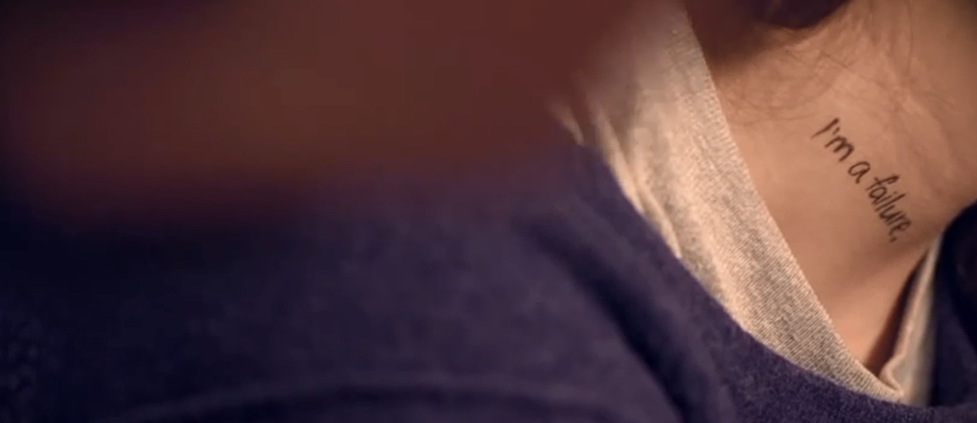
Video
https://www.youtube.com/v/okoaXZboZCI?start=0&end=95
- Youtube
Notes:
Video – It Gets Brighter - https://www.youtube.com/v/okoaXZboZCI?start=0&end=95
Image – Screengrab – It Gets Brighter Video

Slide 14

How can you deal with it?
There is no set method for dealing with a mental illness.
It can help to understand what you have.
Talk to family and friends – sometimes having a conversation is the best way.
Hobbies and music can also be calming
You can always seek help from GPs, school or nurses
Notes:
Discuss the video with the class – how those people would be feeling and how they can deal with it.
Image – Conversation – https://upload.wikimedia.org/wikipedia/commons/f/f0/Two_young_people_demonstrating_a_lively_conversation.jpg – Labelled for Reuse with Modification

Slide 15
Where Can You Go?
Mind
B-eat
Rethink
Sane
Anxiety UK
SAFE
Young Minds
Hearing Voices Network
Bipolar UK
Mood Swings
Samaritans
Teachers and Parents
There are so many organisations there to help.
For contact information and other organisations who deal with mental health issues then have a look at the directory – ask your teacher or a senior member of staff for this after the assembly.
Notes:
Discuss the many options – tell them to ask teachers. Directory should be available at the school – ask students to look if they feel they need to after the assembly.

Slide 16
Mental Health
Kent Youth County Council
www.kent.gov.uk/kycc

